Slide 1
Nvidia: A Deep Dive
Nathan Ketterlinus

Slide 2
Nvidia Biography
Nvidia is a technology company headquartered in Santa Clara, CA.
AI/Deep Learning
Autonomous Machines
Autonomous Vehicles
Graphics and Simulation
High Performance Computing
Developer Tools
My research focused on Graphics and Simulation
Bottom Line: Nvidia is a very successful company, continuing to grow at a rapid pace. They treat their employees well, and information on their customer relations can be found on their subreddit, r/Nvidia

Slide 3
Nvidia’s Industrial Relations
Competes with AMD and Intel
Leads the industry
Rapid growth following COVID-19
 | Market Cap | Quick Ratio | PE Ratio | RoA | EpS
Industry |  | 0.88 | 23 | 7.56%
Nvidia | $1.064T | 2.37 | 109.87 | 14.51% | 4.14
Intel | $147.334B | 1.15 | 90.37 | -0.84% | -0.23
AMD | $166.026B | 1.58 | 55.14 | -0.35% | -0.04

Slide 4
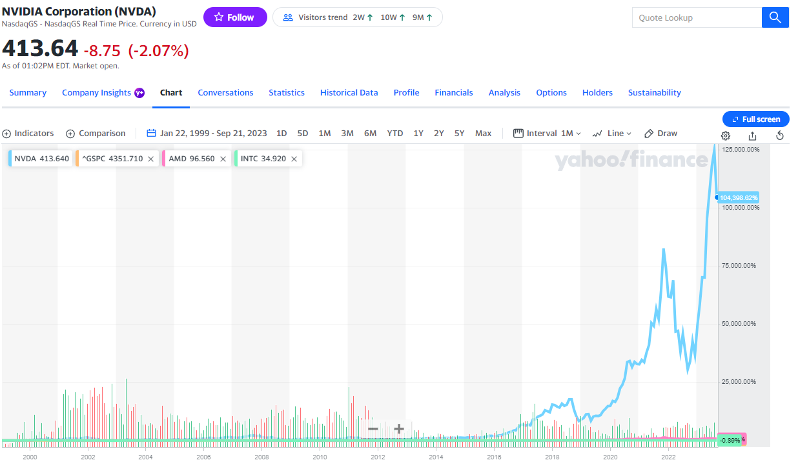
Comparison between Nvidia Corporation (NVDA, light blue), Advanced Micro Devices, Inc. (AMD, Pink), Intel Corporation (INTC, green), and S&P 500 (GSPC, orange), since 1/22/99, scaled by percentage

Slide 5
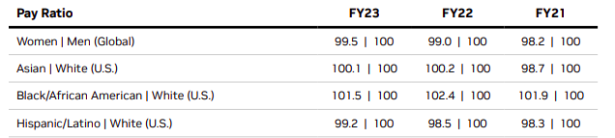
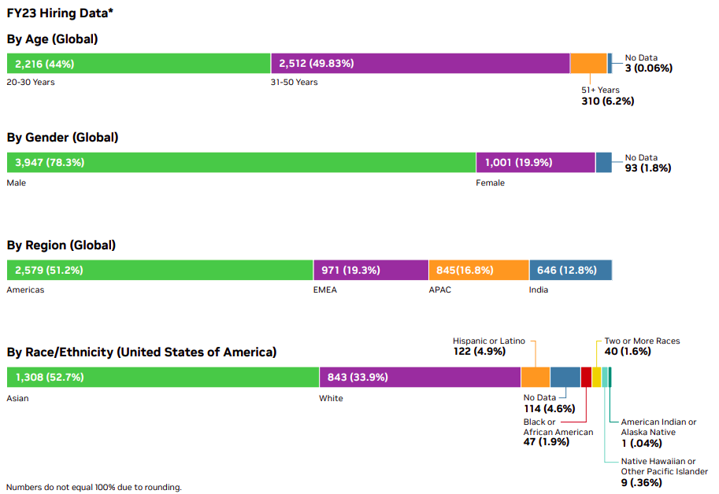
Nvidia’s Employee Relations
Median Wage: $134,213/year
Benefits: $12,474/year
97% of employees agree Nvidia is a great place to work.
4.6/5 rating over 5.2k reviews on Glassdoor

Slide 6
Nvidia’s Customer Relations
 | PCMag.com | Linus Tech Tips | r/Nvidia
Relevance | 6 | 8 | 10
Credibility | 5 | 9 | 7
Currency | 8 | 5 | 10
Depth of Content | 7 | 8 | 6
Bias or Perspective | 4 | 7 | 6
Total /50 | 30/50 | 37/50 | 39/50
Research into various feedback channels
PCMag.com
r/Nvidia
Linus Tech Tips
r/Nvidia is the best source for
customer insight, followed closely by LTT.

Slide 7
In Summary
Nvidia is doing well as a company
Industry leaders financially
Employees are satisfied and well compensated
Customers regularly provide feedback on r/Nvidia

